Slide 1

Car Price Prediction
– By Aman Kumar
Data Science with Python Career Program - Capstone Project

Slide 2

Agenda
Problem Statement
Data Exploration
Data insights
EDA Graphs.
Graphical Analysis and conclusion on Data
Data Cleaning & Pre-Processing Steps.
ML Modeling
Deployment of ML Models using Streamlit.

Slide 3
Problem Statement
Perform EDA and derive Insights from the CAR DETAILS dataset using Various Data Analysis and Data Visualization libraries of Python such as Pandas, Matplotlib & Seaborn.
Create and Deploy a ML Model Which can be accessed by all, using Streamlit and GitHub.

Slide 4
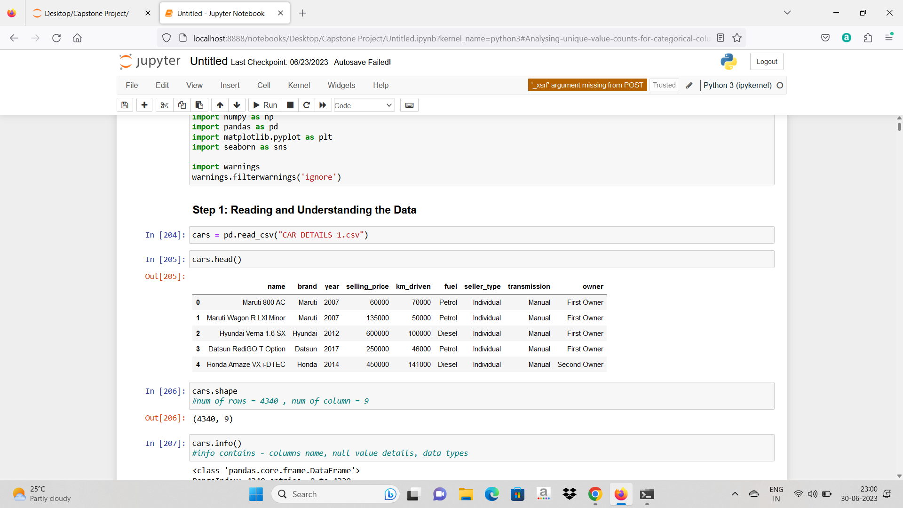
Data Exploration
Data have total Have shape(4340,9) 4340 rows and total 9 column(name, brand, year of purchasing car, current selling price, Km driven , Fuel use by car, Seller type, Transmission of car, Owner) in that I have created a new column name brand , to get the brand name from name column, using excel, then

Slide 5
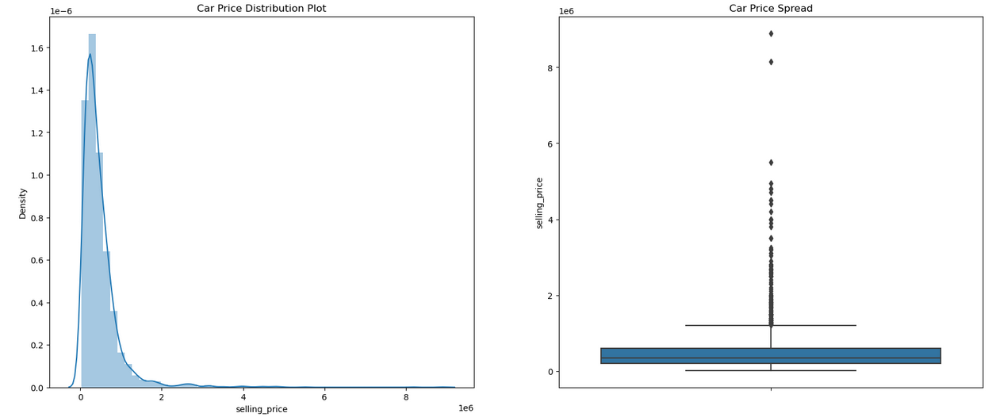
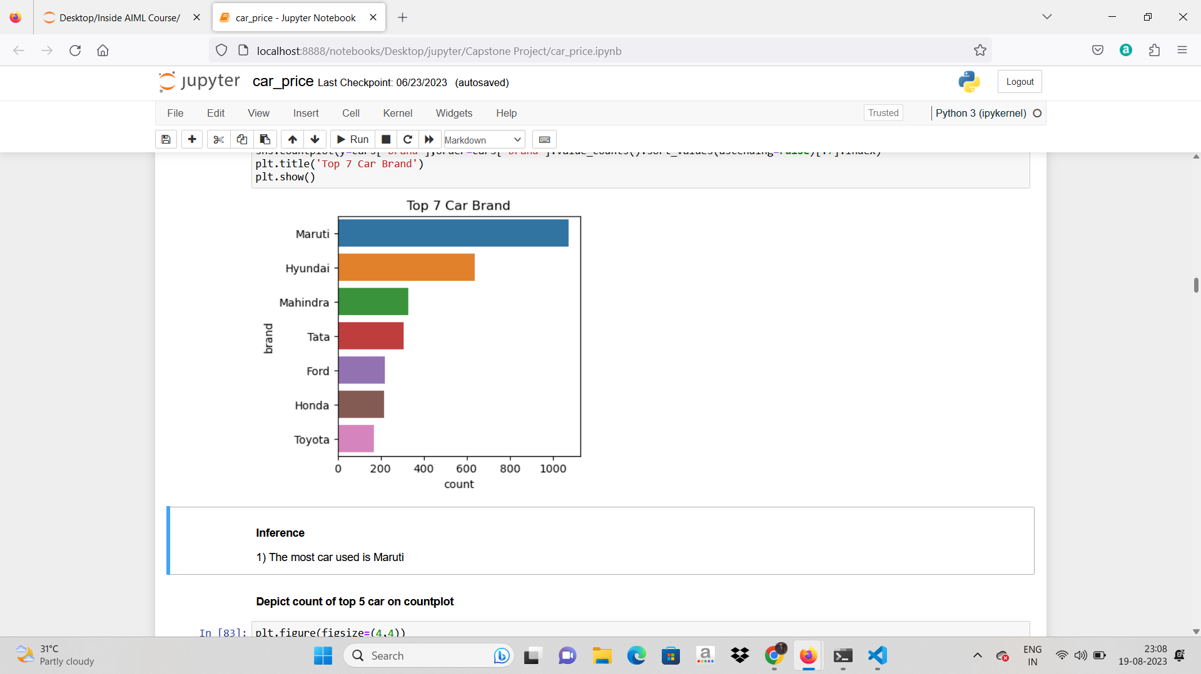
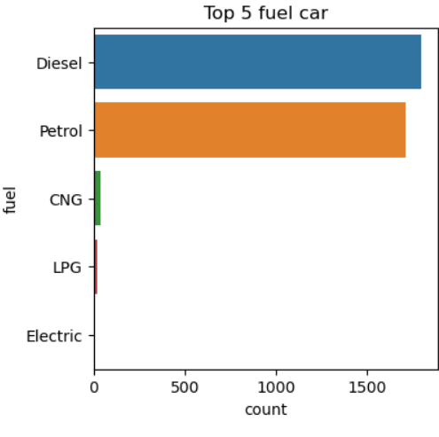
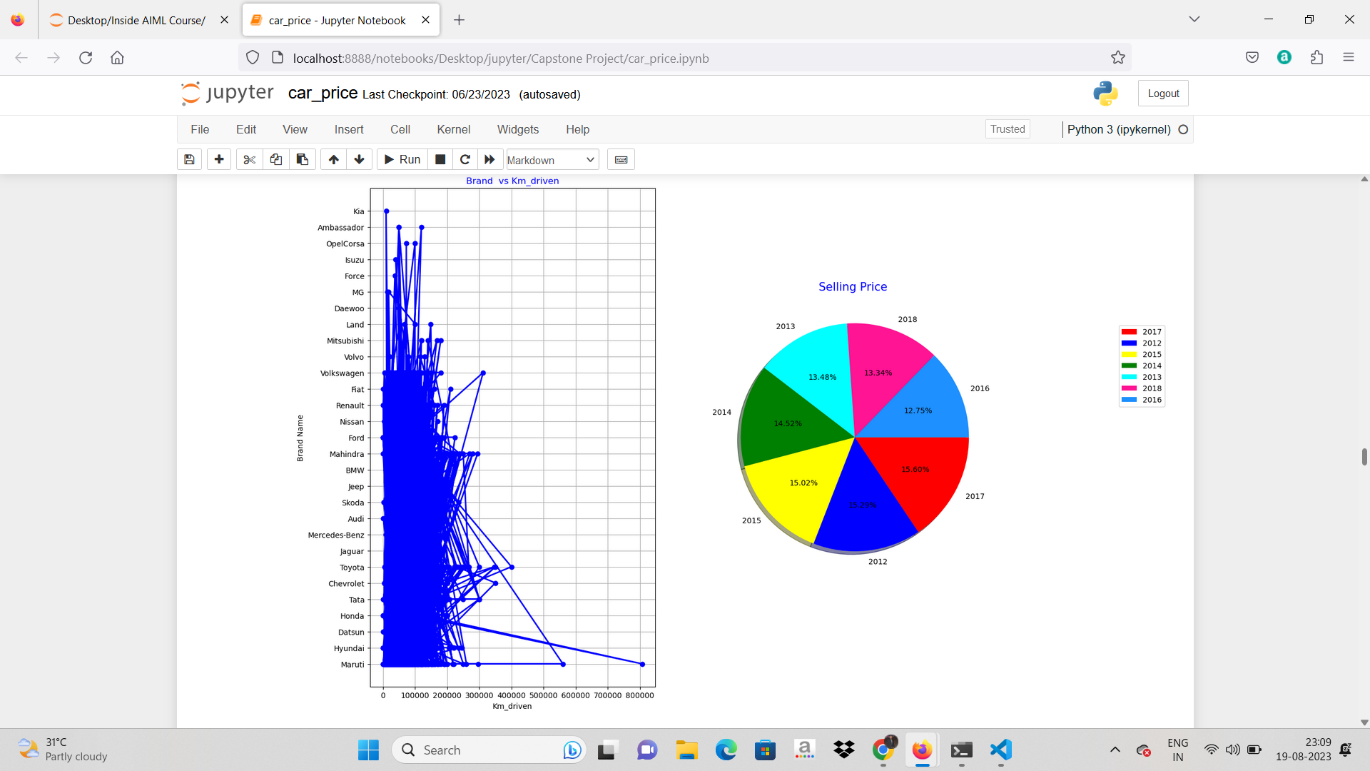
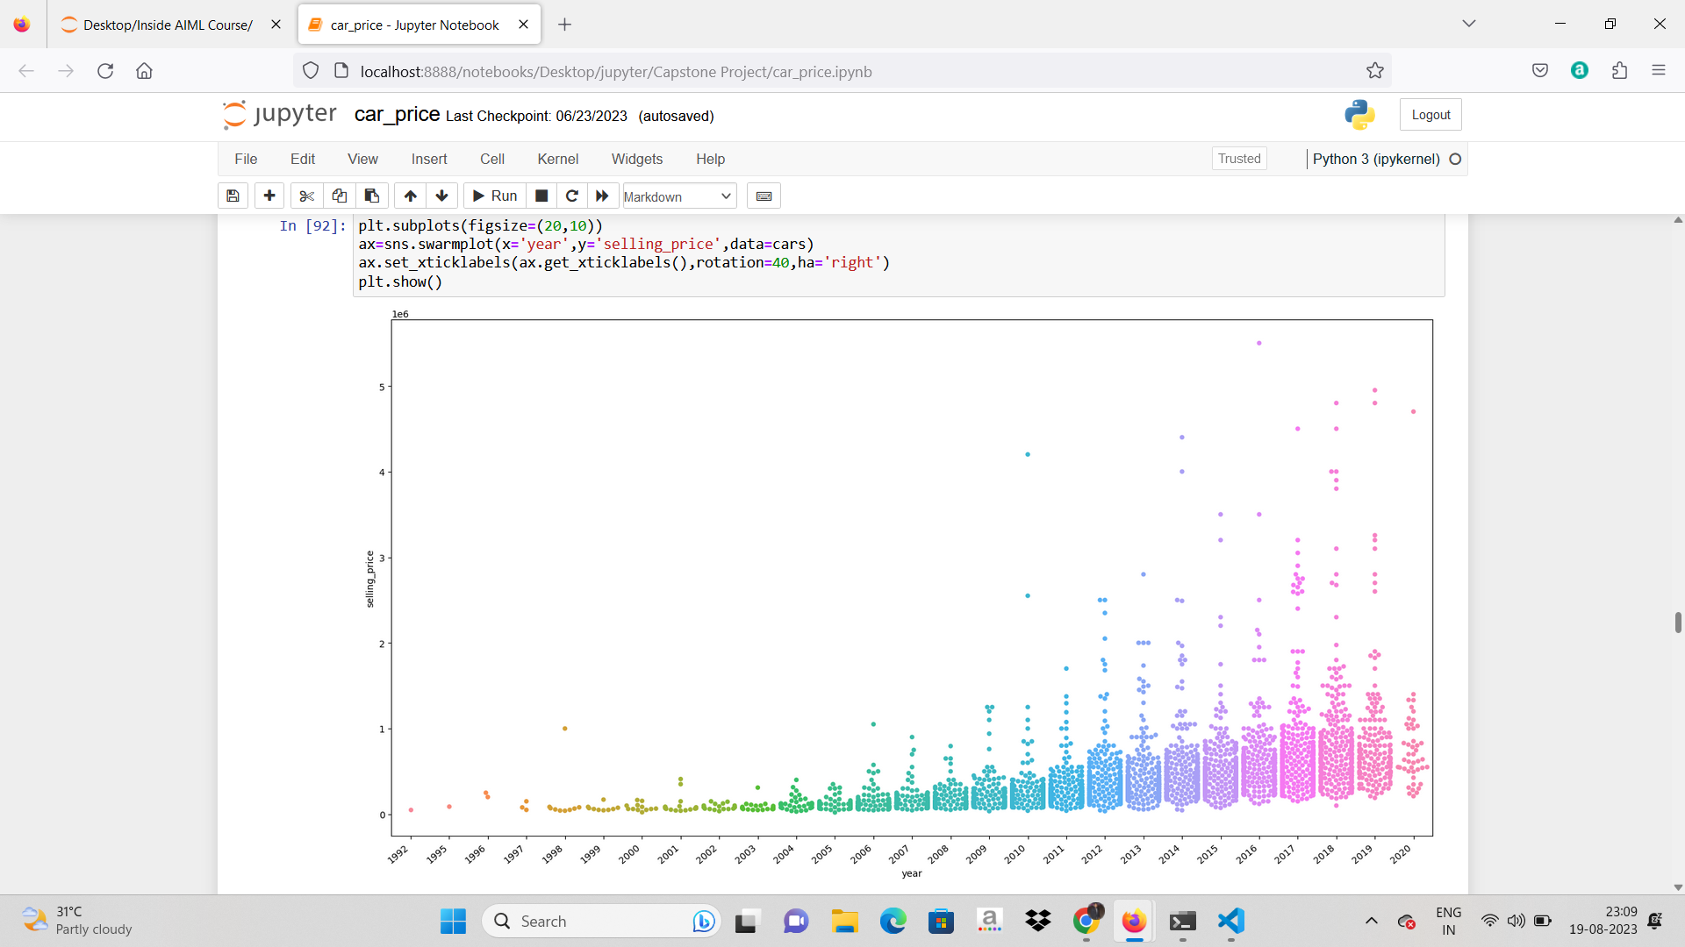
Data insights

Slide 6
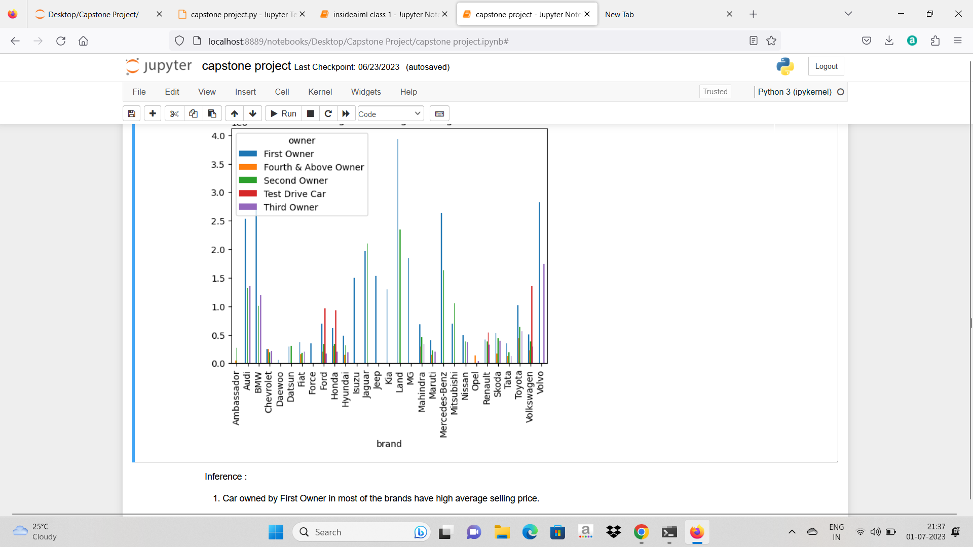
EDA Graphs.

Slide 7
Graphical Analysis and conclusion on Data
There is a significant difference between the mean and the median of the price distribution.
Maruti and Hyundai seemed to be favored car company.
Manual mode car are most favarable.
Most of the cars are on sale by First Seller.
Manual Engine type seems to be most favored type.
Automatics Engine type has the high price range.
Land, Volvo, Mercedes benz and BMW seem to have highest average price.
diesel has higher average price.
Test Drive car have higher average price.
Trustmark Dealer Selling cars at highest price.
we got the cars that has less km driven have high selling price.
Car owned by First Owner in most of the brands have high average selling price.

Slide 8
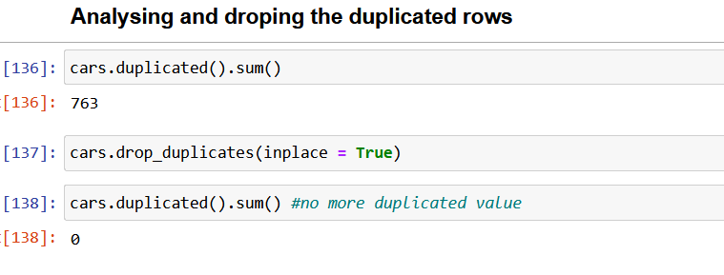
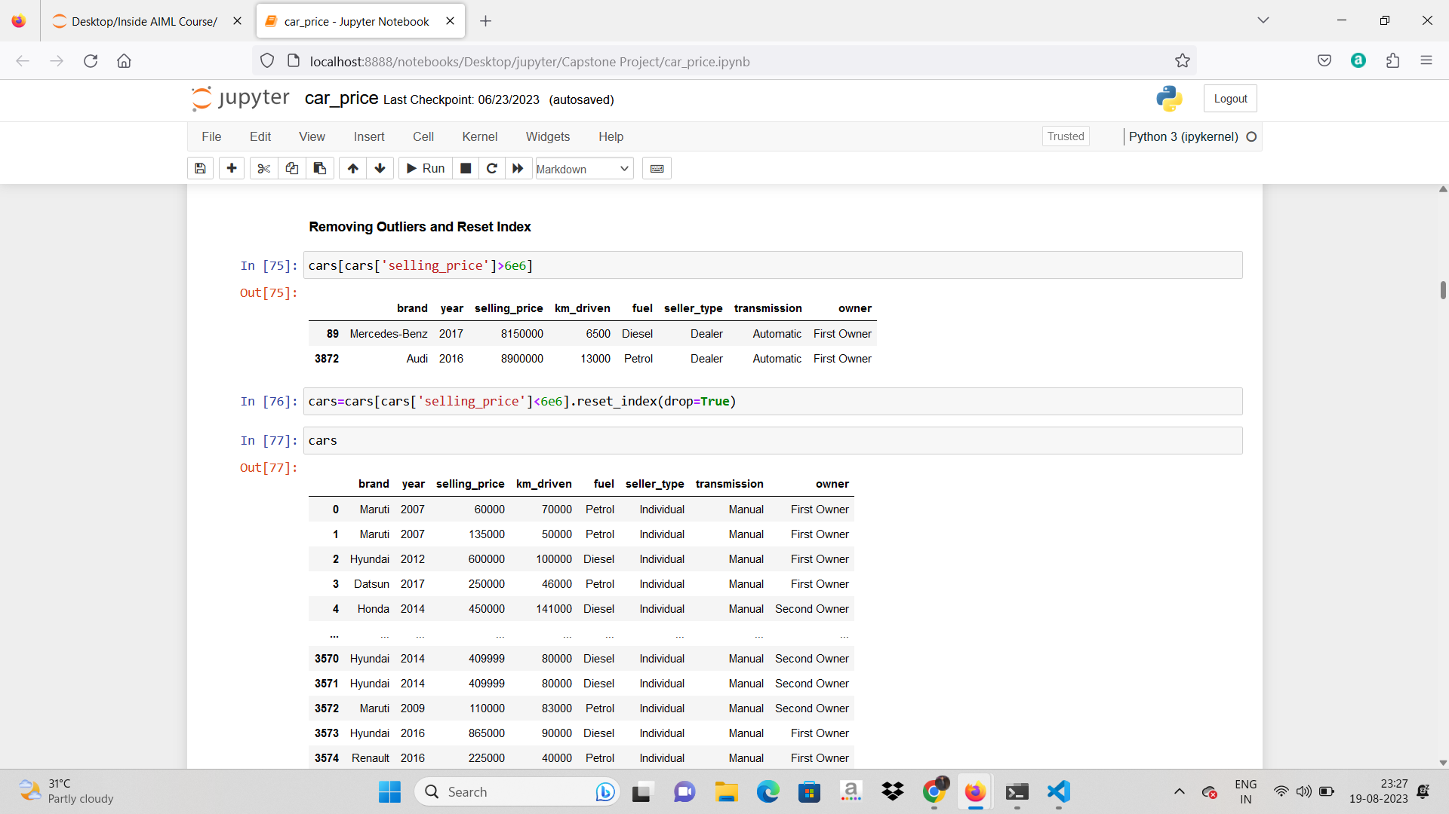
Data Cleaning & Pre-Processing Steps.
Deleted the duplicated rows in data.
Created brand column and removed name Column.
Removed Outliers from Km_driven column and data frame.

Slide 9
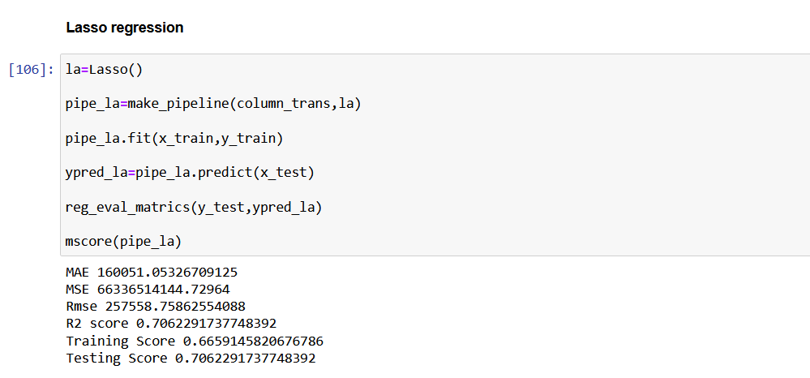
ML Modeling
Lasso Regression Model is selected as it shows Good R2 Score.

Slide 10
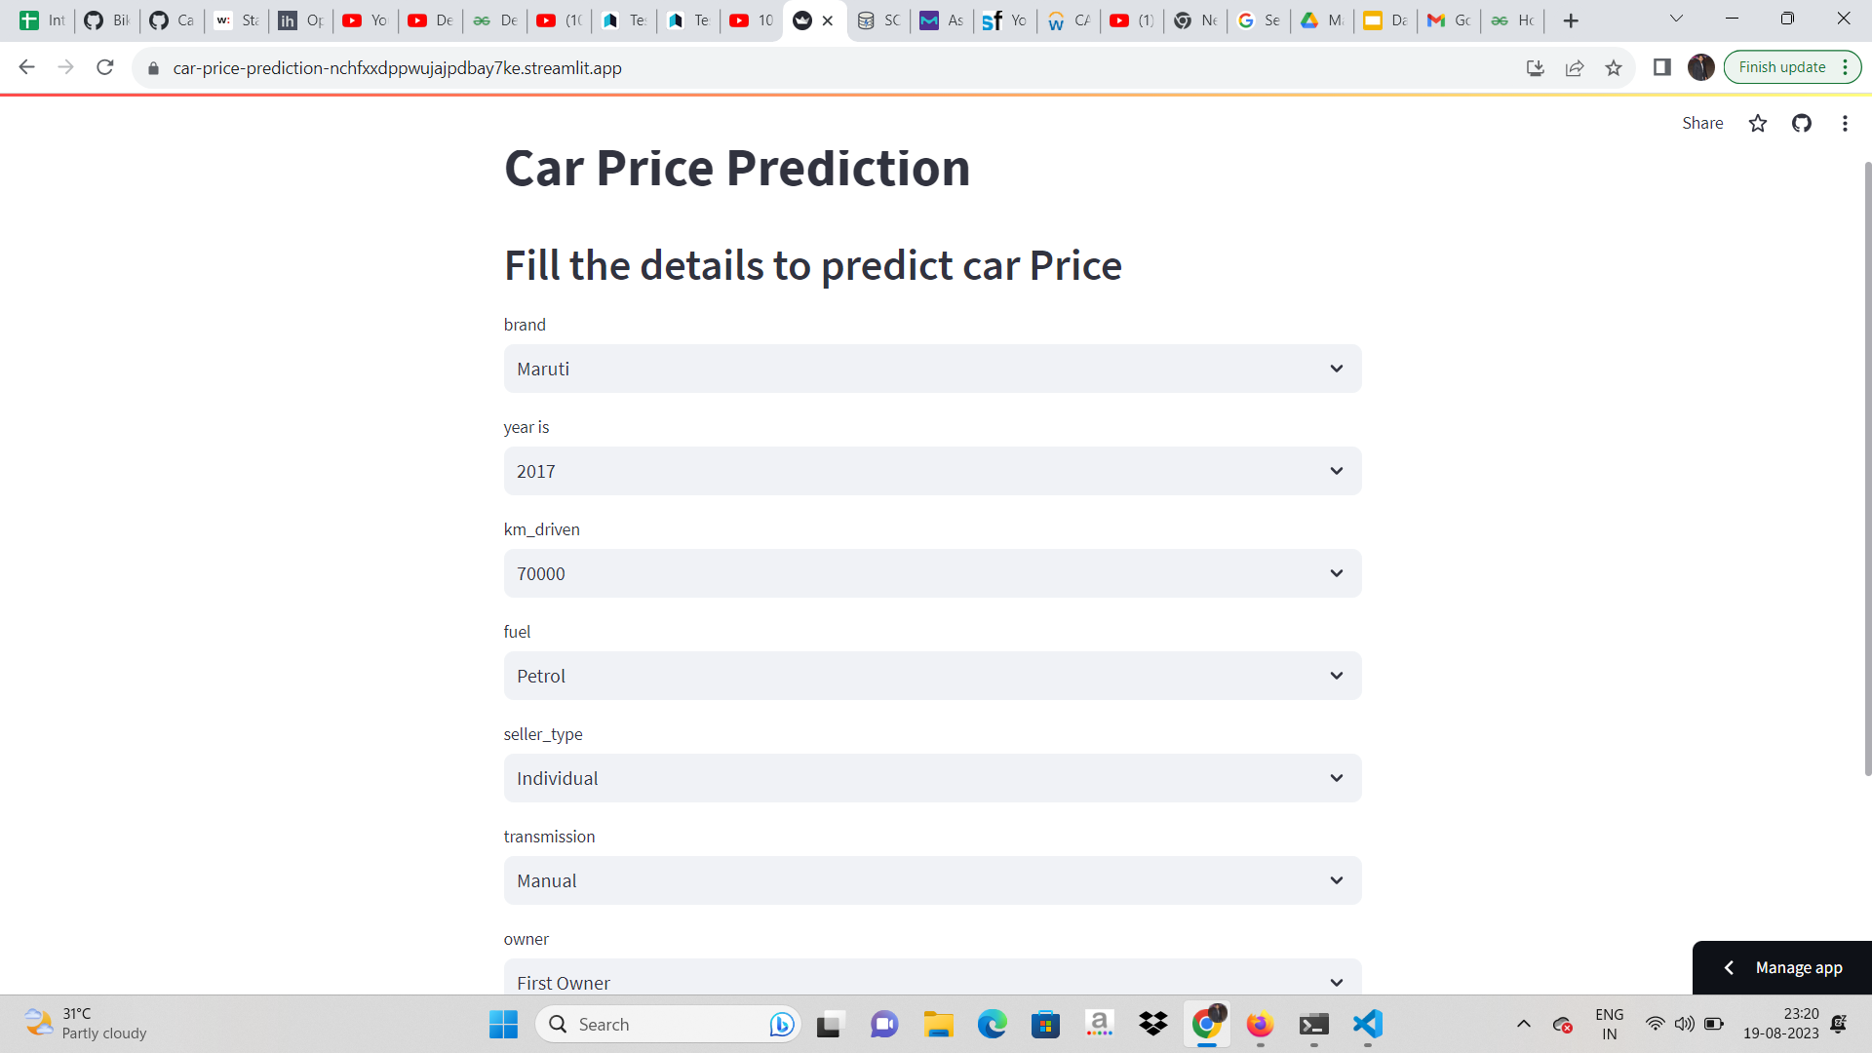
Deployment of ML Models using Streamlit.

Slide 11
Endnotes
Reference Links:-
Link of GitHub GitHub
Link of Streamlit Streamlit App

